Slide 1
Hospital Drive-Time Access for Adults 65+ in the GTA
Presenter: Mohan Mahbaz
Major: Honors Geomatics
Email: mmahbaz@uwaterloo.ca
Created for: GIS Day 2025 – University of Waterloo

Slide 2
Purpose & Data Sources
Purpose
- Purpose
To understand how long it takes to reach a hospital in the GTA and whether areas with more seniors have good access or face longer travel times.
Sources
Population Data: 2016 Census of Population – % of residents aged 65+ by census subdivision (Statistics Canada).
Road Network: 2016 Census Road Network accessed via Scholars GeoPortal.
Hospitals: Ontario Ministry of Health – Hospital locations accessed via Scholars GeoPortal.
Background: Yadgir, S. (2019). Global variation in travel time to the nearest hospital. University of Washington.
Tools
ArcGIS Pro 3.5.0 – Service Area (Network Analysis ).

Slide 3
Methods
Choropleth of % residents 65+ by subdivision
Service Area (5, 10, 15-min) from hospitals
Overlaid drive-times on the choropleth

Slide 4
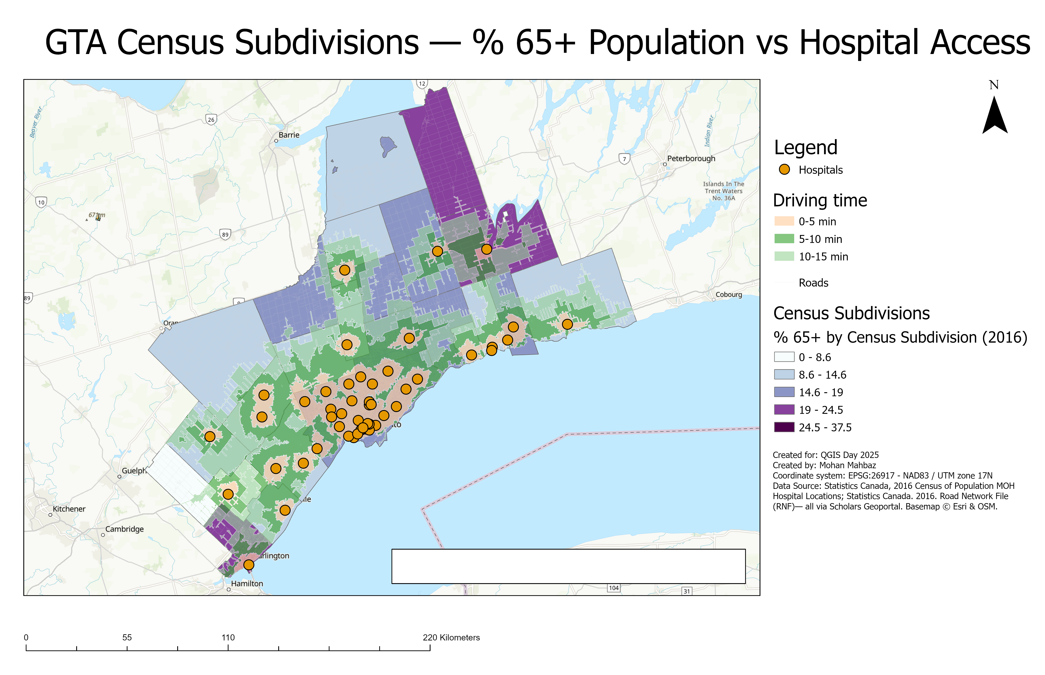
Analysis

Slide 5
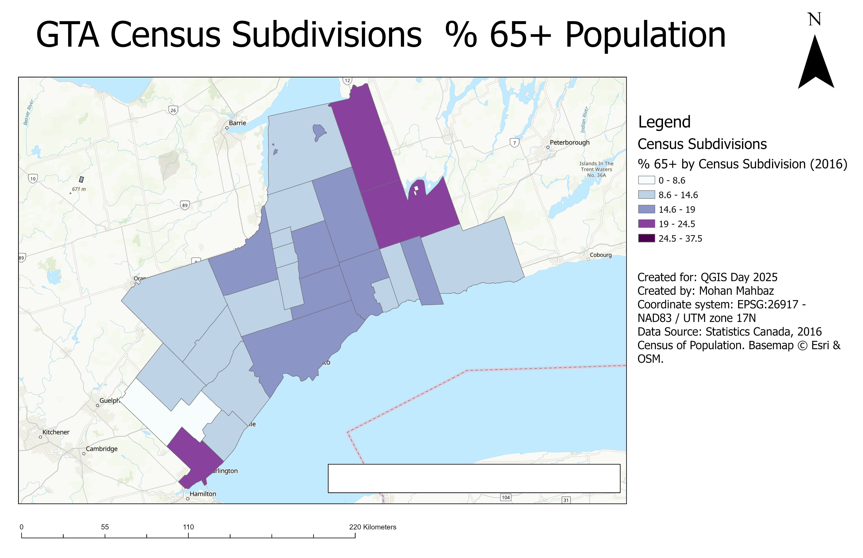

Slide 6
Conclusion & Next Steps
Conclusion
Overall, the GTA is covered well.
“In urban areas globally, the mean travel time to the nearest hospital is ~13 minutes [Yadgir, S. 2019].
In central Toronto, my map shows 5–10 minutes to the nearest hospital.
Suggestion for next time
Rerun the analysis and place a hospital location in Caledon, Brock, and Burlington to test whether travel time drops below 15 minutes.

